Slide 1
Biol 7200: Programming for Bioinformatics Week 7 assignment demos and broken code

Slide 2
Plan for today
Code demos
Broken code
If there’s time, review material

Slide 3
Q1 triangle

Slide 4
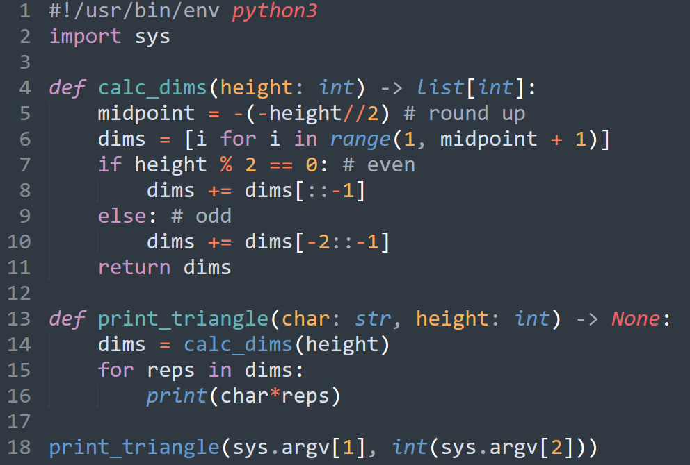

Slide 5
Q2 paired-entheses

Slide 6
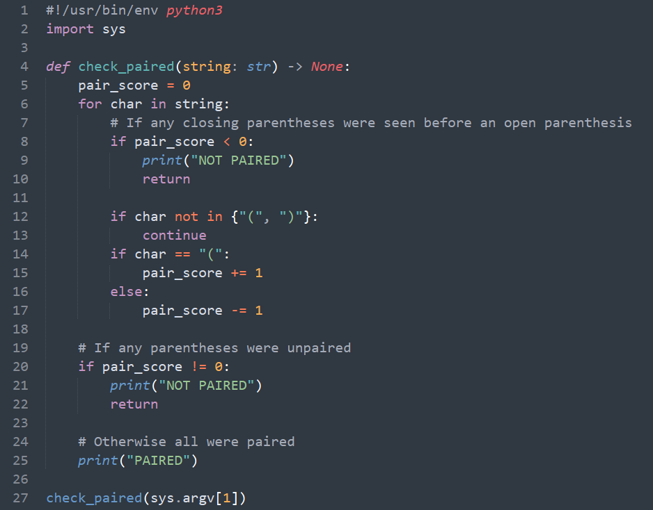

Slide 7
Q3 get homolog sequences

Slide 9
End of demos
Next, broken code

Slide 10
Broken code structure reminder
What’s it trying to do?
What’s wrong with it?
How would you fix it?

Slide 11
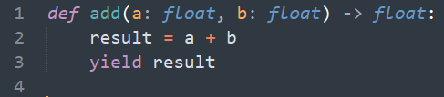
Broken code 1
What’s it trying to do?
What’s wrong with it?
How would you fix it?

Slide 12
Broken code 1
What’s it trying to do?
Calculate the sum of two numbers
What’s wrong with it?
yield produces a generator
Return type is not float, it is Generator
How would you fix it?
Use return keyword instead

Slide 13
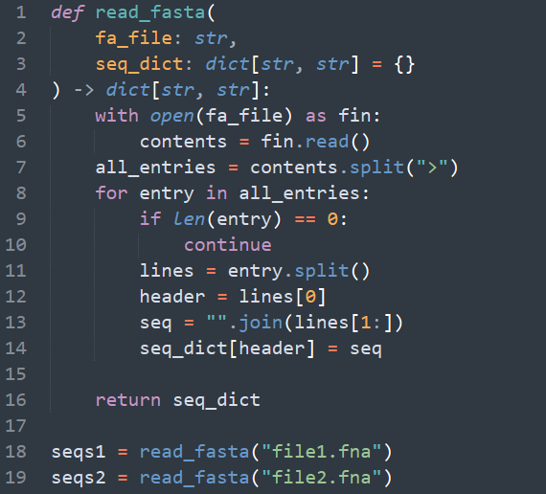
Broken code 2
What’s it trying to do?
What’s wrong with it?
How would you fix it?

Slide 14
Broken code 2
What’s it trying to do?
Use a function to read two fasta files into dicts
What’s wrong with it?
Function defaults are created when the function is defined, not called. All calls will use the same dict instance
seqs2 will contain the sequence from file1.fna
How would you fix it?
Replace seq_dict with an empty dict within the function body if no input given. i.e.
def read_fasta(fa_file, seq_dict=None):
if seq_dict is None:
seq_dict = {}
…

Slide 15
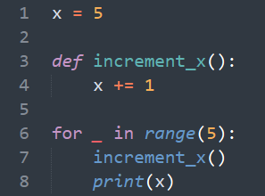
Broken code 3
What’s it trying to do?
What’s wrong with it?
How would you fix it?

Slide 16
Broken code 3
What’s it trying to do?
Use a function to increment a number within a loop
What’s wrong with it?
Whenever an assignment operator is used inside a function, it creates a variable with local scope
x becomes a local variable within increment_x() not the x defined on line 1
How would you fix it?
Pass x as an argument and return x
Avoid using global variables in functions (except constants if you need to). It is harder to read and understand

Slide 17
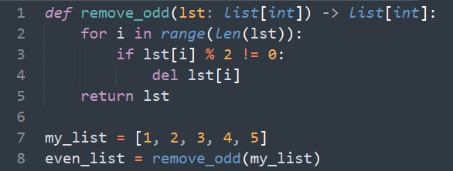
Broken code 4
What’s it trying to do?
What’s wrong with it?
How would you fix it?

Slide 18
Broken code 4
What’s it trying to do?
Use a function to remove odd numbers from a list
What’s wrong with it?
Changing a list when iterating over it changes the length, but not the already running range function
You get an index error if you delete any elements
How would you fix it?
Copy even numbers to a new list
Or iterate over the list in reverse. i.e., reversed(range(len(lst)))

Slide 19
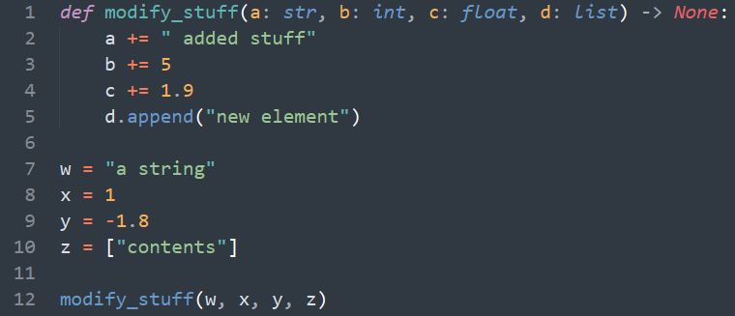
Broken code 5
What’s it trying to do?
What’s wrong with it?
How would you fix it?

Slide 20
Broken code 5
What’s it trying to do?
Use a function to modify objects of different types
What’s wrong with it?
When modifying immutable types, a new instance is created
Only the list is actually modified
How would you fix it?
Return the modified objects and overwrite the originals

Slide 21
End of Lesson

